Slide 1
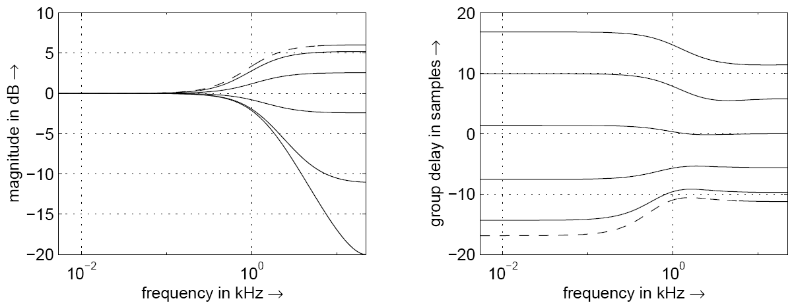
Head shadowing and ITD
Magnitude and group delay of head shadowing / ITD block
Azimuth from 0 (dashed) to π in steps of π/6

Slide 2
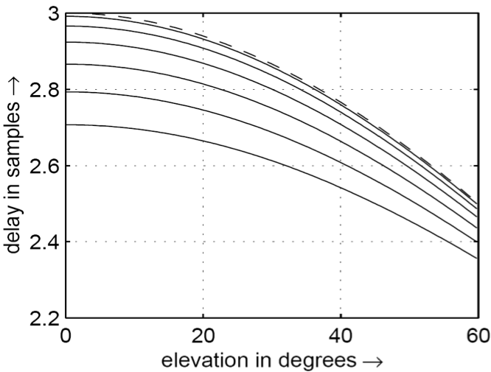
Delay time of first pinna echo
First echo time is function of azimuth and elevation
In this plot, azimuth ranges from 0 to π/2
Steps of π/12
Corresponds to frequency notch between 7-10kHz
Notes:
The parameter D_{n} allows the adjustment of the model to the individual characteristics of the pinna, thus providing an effective knob for optimizing the localization properties of the model. Figure depicts the delay time of the first pinna echo as a function of azimuth and elevation. The corresponding frequency notch lies somewhere between 7 and 10 kHz.
Delay time (in samples at fs = 44100 Hz) of the first echo generated by the pinna as a function of azimuth and elevation. Azimuth ranging from 0 (dashed line) to π/2 at steps of π/12.

Slide 3
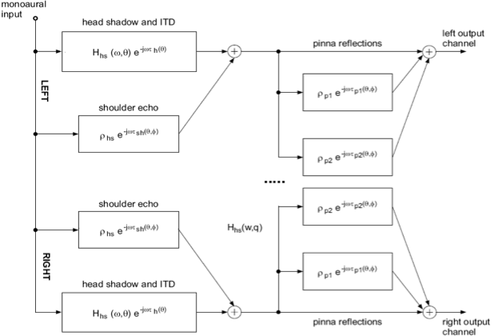
Structural model
Pinna-head-torso
system
Notes:
The structural model of the pinna-head-torso system is depicted in Figure with all its three functional blocks, repeated twice for the two ears. Even though the directional properties are retained by the model, anechoic sounds filtered by the model do not externalize well. As we have explained, there are several ways to improve the externalization in binaural listening.

Slide 4

Azimuth
azimuth angle measured
0’ is straight ahead
90’ is the right ear
elevation kept at 0’
Both pinna filter & head shadow/ITD applied
45’
135’
225’
315’
Notes:
In these demos the azimuth angle is measured where 0’ is straight ahead, and 90’ is the right ear. The file name indicates the number of degrees of azimuth, with the elevation kept at 0’. Both pinna filter and head shadow/ITD are applied

Slide 5
Elevation
90’ is straight up, –90’ is straight down
Elevation 60’, azimuth 0’
Elevation -60’ , azimuth 0’
HRTF applies filtering even when both azimuth & elevation angles =0
Unprocessed mono
Stereo, elevation 0’, azimuth 0’
Notes:
In describing elevation, 90’ is straight up and –90’ is straight down.
Elevation 60’, azimuth 0’
Elevation -60’ , azimuth 0’
HRTF applies filtering even when both azimuth and elevation angles are zero. Compare it with the unprocessed Tom’s diner clip here:
Unprocessed mono Tom’s diner
Stereo, elevation 0’, azimuth 0’
The elevation cues are much harder to notice and pick up on than the azimuth cues. One reason for this, as discussed in the text, is that the HRTF parameters often need to be fine-tuned to a particular user’s ears.

Slide 6
Code

Slide 7
Rotation matrix
initial_angle = -40; %in degrees
final_angle = 40; %in degrees
segments = 32;
angle_increment = (initial_angle - final_angle)/segments * pi / 180;
% in radians
lenseg = floor(length(monosound)/segments) - 1;
pointer = 1;
angle = initial_angle * pi / 180; %in radians
for i=1:segments
A =[cos(angle), sin(angle); -sin(angle), cos(angle)];
x = [monosound(pointer:pointer+lenseg);
monosound(pointer:pointer+lenseg)];
y = [y, A * x];
angle = angle + angle_increment; pointer = pointer + lenseg;
end;

Slide 8
changing delay of signal over time
Ts = 1/fs;
%shift left to right
delay = .001; % in seconds
shift = round(delay/Ts); %shift time in samples
%right channel starts delayed by 1ms
L = [zeros(shift*2+length(x),1)];
R = [zeros(shift,1);x;zeros(shift,1)];
N = length(L);
samples_per_shift = round(N/(shift*2));
x_index = 1;
%insert extra samples at fixed intervals
for(i=1:N)
L(i) = x(x_index);
if(mod(i,samples_per_shift) ~= 0)
x_index = x_index + 1;
end
end

Slide 9
Crossfading between left and right
Ts = 1/fs;
sweepfreq = .5; %sweep frequency in Hz
u = [2^(-1/2);2^(-1/2)];
g = zeros(2,length(x));
L = zeros(1,length(x));
R = L;
%exponents change from 0 to 3
for(n = 1:length(x))
exL = 1.5*(1+sin(2πn*sweepfreq/fs));
exR = 3 - exL;
L(n) = x(n)*10^{-exL};
R(n) = x(n)*10^{-exR};
end
y = [L',R'];

Slide 10
Change amplitude over time using rotation matrix
Ts = 1/f_{s};
sweepfreq = 0.2; %sweep frequency in Hz
%positive angle to left, negative to right
%Code for changing angle
θ= zeros(1,length(x));
u = [2^{-1/2};2^{-1/2}];
g = zeros(2,length(x));
L = zeros(1,length(x));
R = L;
for(n = 1:length(x))
θ(n)=(π/4)*sin(2πn*sweepfreq/f_{s});
A=[cos(θ(n)),sin(θ(n));-sin(θ(n)),cos(θ(n))];
g(:,n) = A*u;
L(n) = x(n)*g(1,n);
R(n) = x(n)*g(2,n);
end
y = [L',R'];
Code for fixed angle
THETA = pi/6;
A=[cos(θ),sin(θ);-sin(θ),cos(θ)];
g = A*u;
L = g(1)*x;
R = g(2)*x;

Slide 11
Head Shadow and ITD code
θ =θ + 90; θ is angle with frontal plane
θ₀ =150;α_{min} =0.05 ;
c = 334; a =0.0891; speed of sound, radius of head
ω₀ =c/a;
α =1+α_{min}/2 + (1-α_{min}/2)* cos(θ/θ₀*π);
numerator of Transfer Function
B = [(α+ω₀/f_{s})/(1+ ω₀/f_{s}), (-α+ω₀/f_{s})/(1+ ω₀/f_{s})];
denominator of Transfer Function
A = [1, -(1- ω₀/f_{s})/(1+ ω₀/f_{s})] ;
if (abs(θ) < 90) gdelay = -f_{s}/ ω₀*(cos(θ*π/180) - 1);
else gdelay = f_{s}/ω₀*((abs(θ) - 90)*π/180 + 1);
a = (1-gdelay)/(1+gdelay);
allpass filter coefficient
out_{magn} = filter(B, A, input);
output = filter([a, 1],[1, a], out_{magn});

Slide 12
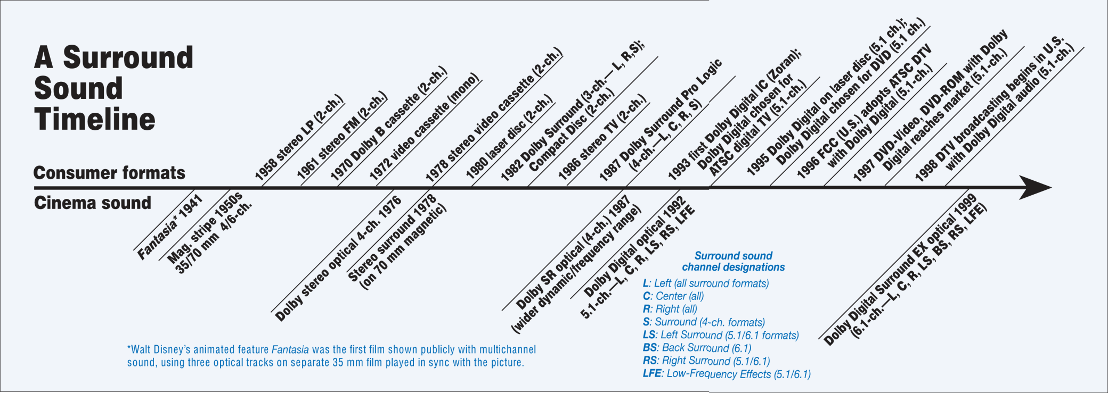
The Dolby Evolution
1941, Fantasia – First Multichannel Audio
1986 – Stereo TV!!
1987 – 4ch Pro Logic
1992 – Dolby Digital 5.1
Notes:
Dolby has been using multichannel surround since 1941. There are some important differences between the original dolby pro logic and todays 5.1 and 7.1 formats. The original surround was matrixed to a 2channel carrier format using phase inversion to reproduce the signal if rear channels were available on playback. Now the audio carrier is fully discrete and has separate metadata that contains information on the downmix settings for stereo reproduction.

Slide 13
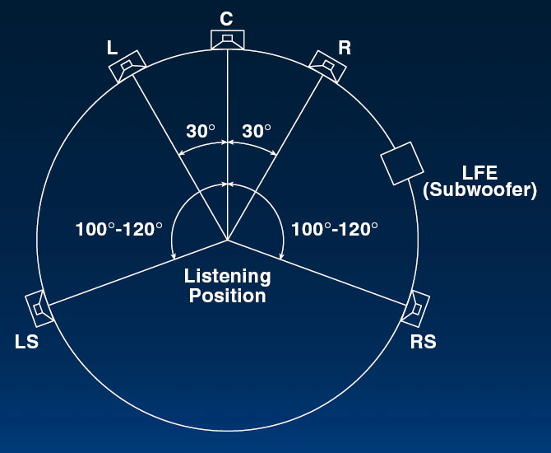
ITU Recommended 5.1
5 Full bandwidth channels
Low Frequency Extension channel
All speakers equidistant
Variations with rear channel at +/-135
Large Gap between surround channels
Notes:
Panning sources in 5.1 uses sine/cosine law.

Slide 14
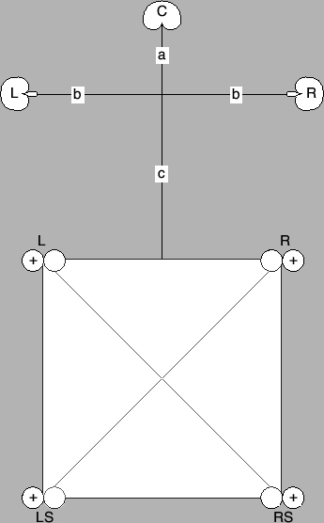
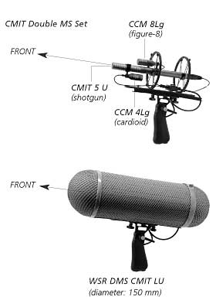
5.1 Recording Arrays
Hamasaki Square
Schoeps Double MS
Notes:
There have been many microphone arrays developed for recording in 5.0 or 5.1. Some of these are shown in the pictures and are Surround Decca Tree, Double MS and Hamasaki Square. These techniques have specific places where each microphone should be panned and quite often it can be a microphone per speaker arrangement. My personal favourite of these has been the Surround Decca Tree, which will be demonstrated later. One of the best attributes is that this method makes use of the law of the first wave front or the Haas effect. A Great resource for recording in 5.1 is Rumsey’s Spatial Audio.

Slide 15
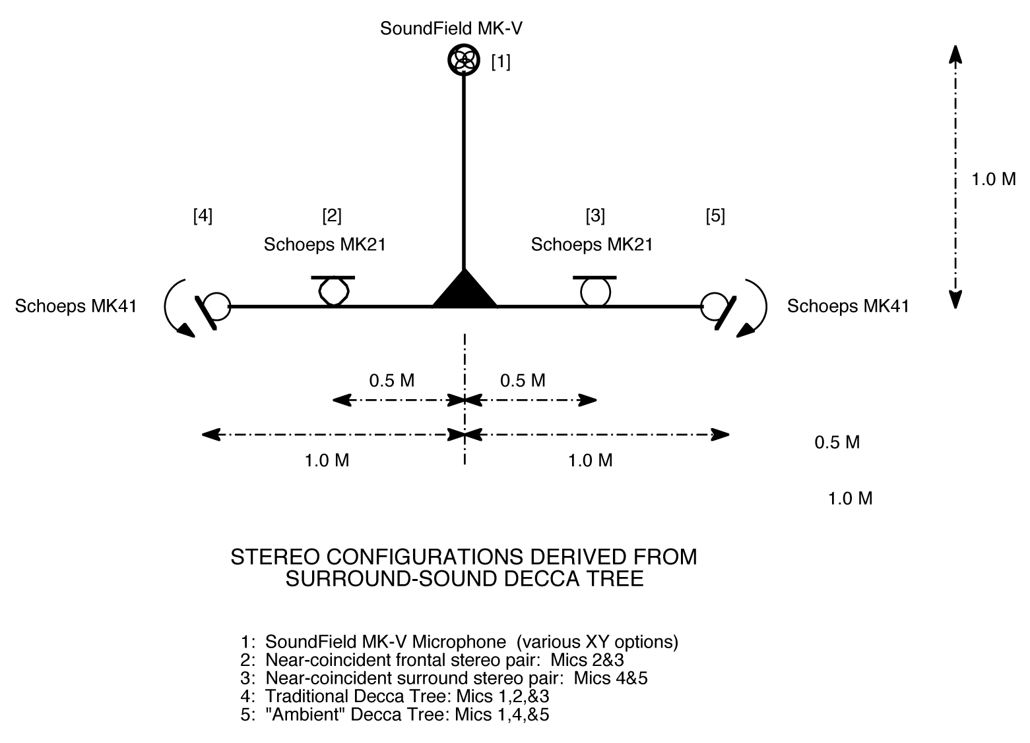
Surround Decca Tree
www.wesdooley.com/pdf/Surround_Sound_Decca_Tree-urtext.pdf
Notes:
The Decca Tree is a spaced microphone array most commonly used for orchestral recording
Talked bout: Correlation/Decorrelation, issues of stereo or mono compatibility

Slide 16

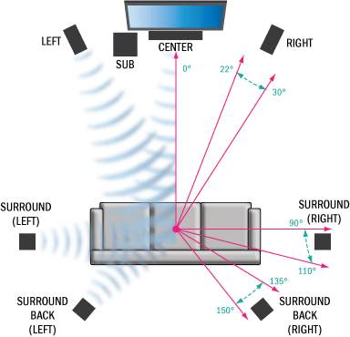
7.1 Speaker Layout
Notes:
In 7.1 the front 3 channels are in the same positions as 5.1. The 5.1 rear channels can be left in the same position but are now the side channels. The extra two channels are positioned at +/-135 to 150 degrees. To note when using 7.1 on some microsoft operating systems the side and rear channels are mapped the wrong way round.

Slide 17

Improvement over 5.1
Fills most of 5.1 gaps
Still suitable for home users
BluRay uses 8 uncompressed full bandwidth channels
192KHz 24Bit over HDMI 1.3
Backwards compatibility to 5.1 and its Dolby and DTS formats
Notes:
The improvements that 7.1 offers over 5.1 is filling some of the gaps between the speakers that were present in 5.1. By adding extra rear channels there is now not a 140 degree gap between surround left and surround right. And for accommodating the home user setup, there’s still going to be space between the sofa and tv to walk around the room.

Slide 18
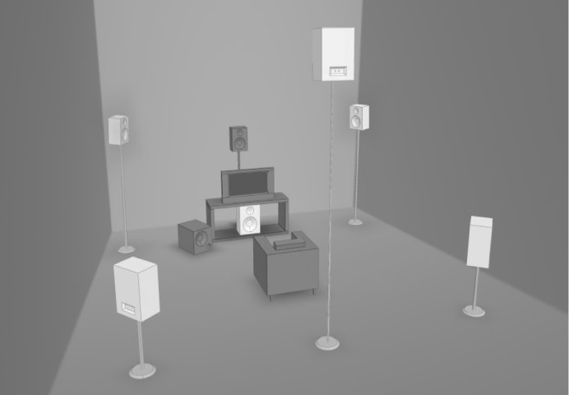
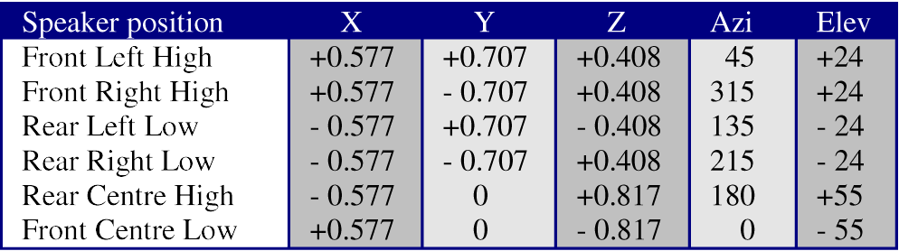
3D7.1
Almost compatible with 5.1
Gives height information
Uses a Tetrahedron for equidistant speaker locations
Notes:
At the latest AES Conference, Audio for Games, Simon Goodwin proposed a 3d speaker layout that he called 3D7.1. Simon worked within the limits of HDMI 1.3 where it is possible to have 8 uncompressed full bandwidth channels, though he actually used the limitations of 7.1 hardware and kept one channel as the LFE. He used Gerzon’s proposal from the 1970s of using a tetrahedron, so the speakers were equidistant from the user. The downside to this method is that there is limited height information and its only nearly 5.1 compatible.

Slide 19
3D7.1 Picture
Notes:
As can be seen in the picture the layout suggested is somewhat limited in its height reproduction around a 360 degree horizontal, notably with no speaker above the user. However based upon the hardware limitations it is a viable option and a step in the right direction for home 3D audio.

Slide 20
Ambisonics
Developed in the 1970s by Michael Gerzon
Based upon Spherical Harmonics
This is known as B Format Ambisonics
Notes:
Ambisonics was developed in the 1970s with most credit going to Michael Gerzon. This has been a system used by many for 3D playback since its introduction. Ambisonics is based on the principles of spherical harmonics. A sound source is given a chosen azimuth and elevation and based on these it is decomposed into directional elements. The W component is an omnidrection component, X is a front to back figure of 8 directional component, depending on literature Y is right-left directional component or vice verse and Z is an up down figure of 8 directional component. W is known as zeroth order and XYZ are called first order. These are known as the encoding equations, which are the main equations that people try to change to adapt ambisonics.

Slide 21
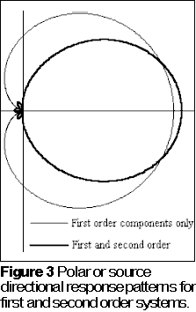
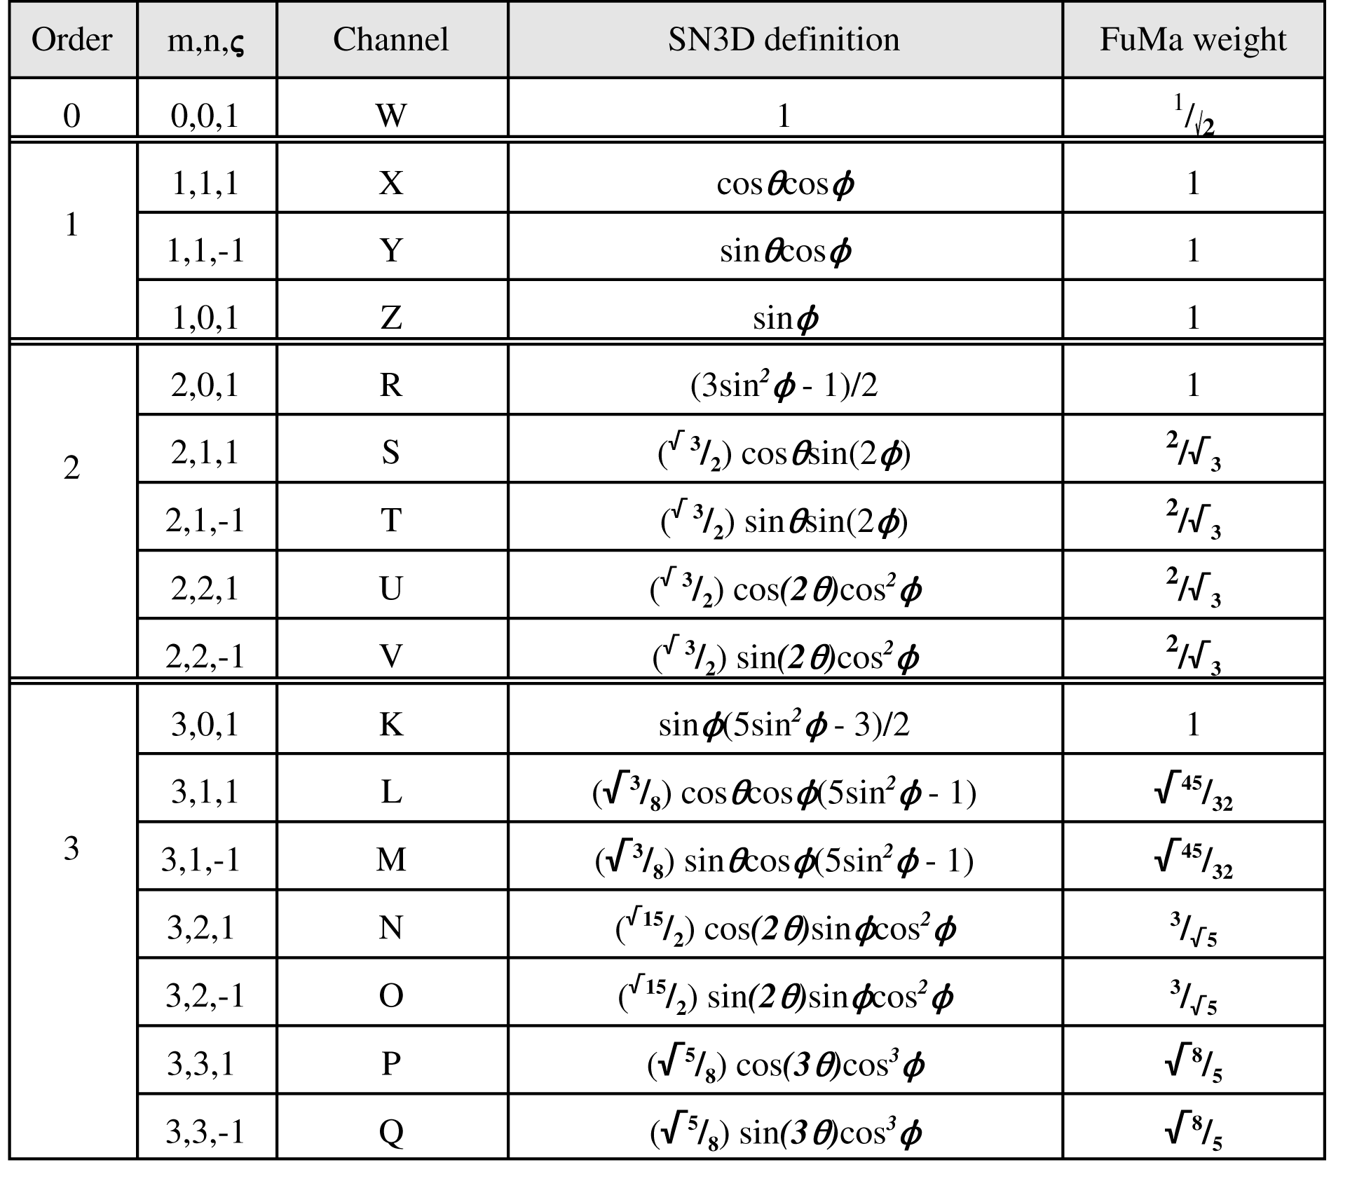
Higher Orders
Higher Orders Give Better Spatial Resolution
Notes:
The use of higher orders gives higher spatial resolution. Higher orders use more directional components, as the order increases the previous orders are always used as well, it is an additive system. You can see from the pictures that as the order increases the cardioid lobe produced becomes narrower with greater directional accuracy although more rear and side lobes are produce. The lobes, however decrase in amplitude as the order increases and spread over a wider area making them less distractive to the listener.

Slide 22
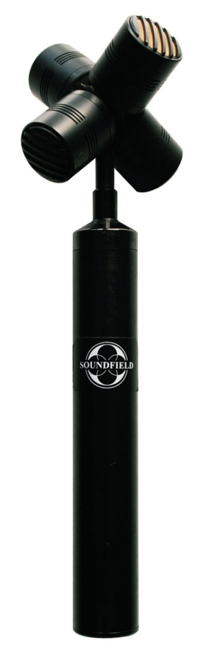
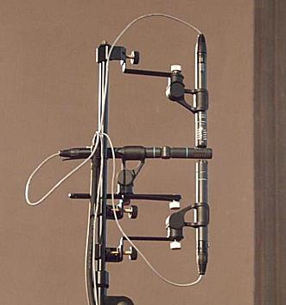
Recording Ambisonics
A Format Tetrahedral Microphone
Native B Format Microphone Arrays
Tetrahedral Arrays Are A Format Ambisonics
Notes:
Gerzon in his great wisdom helped develop the first Soundfield Microphone for recording ambisonics. Ambisonics from the beginning was both a format for recording, playback and panning synthesised sounds, this differs to any other format talked about here today. This uses a tetrahedral array of 4 microphone capsules which are known as A Format. These signals are then added and subtracted to produce the different W X Y and Z components for 1st order B Format. A Native B Format array can be set up using 3 figure of eight microphones to produce B Format. The picture show a Soundfield A Format Tetrahedral mic on the left and a native b format array on the right.
Ambisonics is prepanned and can be decoded to any speaker layout.
Lack of standardisation means no common users.

Slide 23
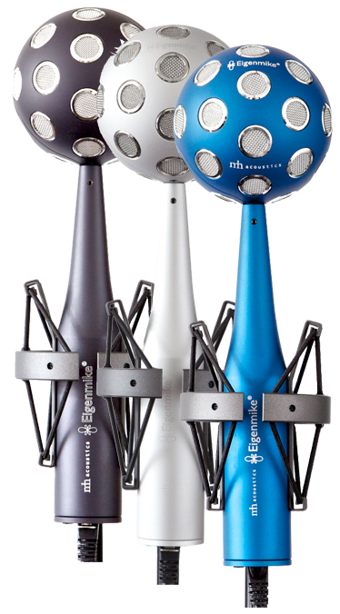
The Eigenmike
32-element microphone array

Slide 24
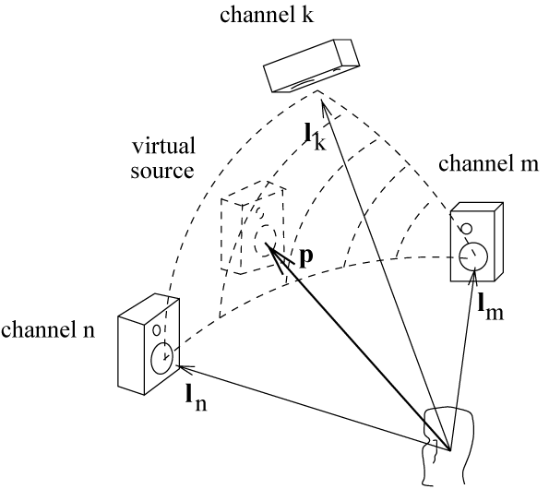
Vector Base Amplitude Panning
Uses a triplet of speakers to localise a source (3D)
Same as tangent law (2D)
Calculate speaker triplet vector same as the point source
Notes:
Like Ambisonics, vbap uses directional components to locate the point source. Using a triangulation based method, vector base amplitude panning uses three speakers in different planes to position a source, as seen in the picture. P is the point source and Ln, Lm and Lk are the speakers. If a source was panned between 2 speakers the resulting gains are identical to the tangent law. The vectors for speaker locations are calculated the same way as the point source vector.

Slide 25
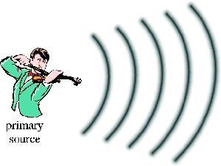
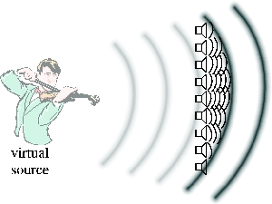
Wave Field Synthesis
Reproduces wave fronts
Highest frequency is determined by speaker distance
Downside is the amount of loudspeakers and cost
Notes:
Wave Field Synthesis is another system for audio playback. In this the user is surround by many loudspeakers. By the use of so many loudspeakers it is possible to produce wave fronts of sound therefore giving better directionality and clarity of sound, this can be seen in the picture of the violinsit. However wavefield synthesis has its frequency range limited by the distance between the speakers. A hybrid method can be implemented to use amplitude panning above the Wave Field Synthesis frequency limit for an arbitrary array.

Slide 26
Questions?
Dolby, www.dolby.com
DTS, www.dts.com
F. Rumsey, Spatial Audio, Focal Press.
R. Streicher, The Decca Tree – Its Not Just for Stereo Anymore,
http://www.wesdooley.com/pdf/Surround_Sound_Decca_Tree-urtext.pdf
C. Eric, T. Chen, “The Native B-Format Microphone by Benjamin,” Audio Engineering Society, Convention 119, 2005.
Schoesps, www.schoeps.de
V. Pulkki, “Virtual Sound Source Positioning Using Vector Base Amplitude Panning,” Audio Engineering Society, Volume 5, Issue 6, pp. 456 -466, June 1997.
S. Goodwin, “3D Sound For 3D Games – Beyond 5.1,” Audio Engineering Society, 35th
International Conference, 2009.
M.A. Gerzon, “Periphony: With-Height Sound Reproduction,” Audio Engineering
Society, vol. 21, pp. 2-10, February 1973.
D. Malham, Higher order Ambisonics systems,
http://www.york.ac.uk/inst/mustech/3d_audio/higher_order_ambisonics.pdf, 2003.
Soundfield, www.soundfield.com
Notes:
So has anybody got any questions about what I’ve talked about today?

